Slide 1














overview
290 80
4 Years
9.5%
2017 2018
Head Count Joined Left
Avg. Tenure
Turnover rate
2019 2020 2021
Availability
Re-Hiring rate
Employee Satisfaction Survey
92
65%
15%
278
Working:
Leave:
Nature of Work
Skill Improvement
Mentoring by
Supervisor
Distribution of work
within team
Work Culture
HR Benefits
Incentive/ Bonus
Head Count by Gender
Avg. AGE -
40
EDUCATION EXPERIENCE DEPARTMENT CONTRACT
Headcount by Education
153
172
B-tech
109
100
45
MBA
87
M-tech
53
0
<30
30-49
50+
Degree
27
Headcount by Age Range

Slide 2







overview
290 80
4 Years
9.5%
2017 2018
Head Count Joined Left
Avg. Tenure
Turnover rate
2019 2020 2021
3:
1
Employee Satisfaction Survey
Re-Hiring rate
Nature of Work
Skill Improvement
Mentoring by Supervisor
Distribution of work within team
Work Culture
15%
15%
278
25%
92
200
84
10%
150
75%
77
30
8%
100
Head Count by Gender
5%
Avg. AGE -
Availability
40
EDUCATION EXPERIENCE DEPARTMENT CONTRACT
65%
Headcount by Education
153
172
B-tech
109
60%
Working:
Leave:
100
MBA
87
58%
45
M-tech
53
55%
0
<30
30-49
50+
Degree
27
Headcount by Age Range

Slide 3


overview
overview
370 290 80
4 Years
9.5%
2017 2018
Head Count Joined Left
Avg. Tenure
Turnover rate
2019 2020 2021
3:
1
Employee Satisfaction Survey
Re-Hiring rate
Nature of Work
Skill Improvement
Mentoring by Supervisor
Distribution of work within team
Work Culture
15%
15%
278
25%
92
200
84
10%
150
75%
77
30
3
8%
100
Head Count by Gender
5%
Avg. AGE -
Availability
40
EDUCATION EXPERIENCE DEPARTMENT CONTRACT
65%
Headcount by Education
153
172
B-tech
109
60%
Working:
Leave:
100
MBA
87
58%
45
M-tech
53
55%
0
<30
30-49
50+
Degree
27
Headcount by Age Range

Slide 4



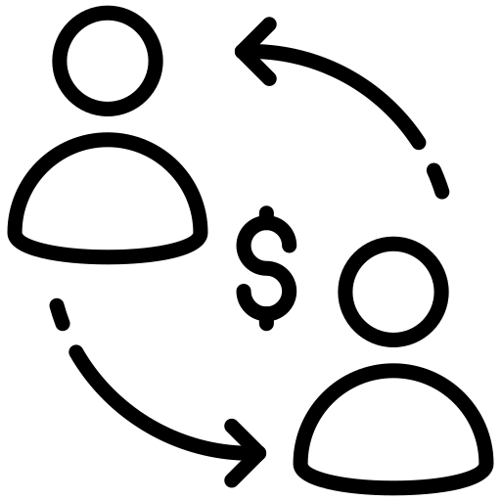



Recruitment Journey
15 Days
50%
2017 2018
80 50 24,000
Total Openings Hired Cost
Time to Hire
Offer v/s Joining
2019 2020 2021
Time to Hire
Hiring rate
Work in Progress
Headcount by Department
Application received
Assessment
Interview
Shortlisted
Joined
23000
50
0 80
1800
Source of Candidates
R & D
R & D
R & D
R & D
R & D
500
R & D
53
Project lead
53
Project lead
Project lead
Project lead
Project lead
Project lead
Software Developer
Software Developer
Software Developer
Software Developer
100
Software Developer
53
Online
1090
Consultant
27
Venter
870
Business Development Executive
50
Internal
853
HR
Social Media
2700

Slide 5






Employee 360
Select Employee Number
Date
All
24/05/2022
24/05/2022
Employee ID
Employee Name
Employee DOB(Age)
Employee Education
Employee department
Employee Designation
Employee Contract Type
: BNX 171
: Vipin Varghese
: 22-02-1995 (27)
: B-Tech
: Delivery Team
: Business Analyst
: Permanent
WORKING
Leave Calendar
Joining Date
Job Tenure
Leave Days
Reporting To
: 01 - 03 – 2022
: 2 Month
: 2
: Alan
1 | 2 | 3 | 4 | 5 | 6 | 7
8 | 9 | 10 | 11 | 12 | 13 | 14
15 | 16 | 17 | 18 | 19 | 20 | 21
22 | 23 | 24 | 25 | 26 | 27 | 28
Manager Rating
4.0
UAE
QATAR
INDIA
UK
Dubai & Abu Dhabi
Al Khaliyadia street, Doha
Kochi & Bengaluru
Whitechapel, London
Worldwide and Growing!
UAE | INDIA | QATAR | UK

Slide 6
Employee 360
Select Employee Number
Date
All
24/05/2020
24/05/2022
Employee ID
Employee Name
Employee DOB(Age)
Employee Education
Employee department
Employee Designation
Employee Contract Type
: BNX 171
: Vipin Varghese
: 22-02-1995 (27)
: B-Tech
: Delivery Team
: Business Analyst
: Permanent
NON - WORKING
Leave Calendar
Joining Date
Last working day
Job Tenure
Reason for leaving
: 25 - 05 - 2020
: 24 - 05 - 2022
: 2 Years
: Better offer.
1 | 2 | 3 | 4 | 5 | 6 | 7
8 | 9 | 10 | 11 | 12 | 13 | 14
15 | 16 | 17 | 18 | 19 | 20 | 21
22 | 23 | 24 | 25 | 26 | 27 | 28
Manager Rating
3.0
UAE
QATAR
INDIA
UK
Dubai & Abu Dhabi
Al Khaliyadia street, Doha
Kochi & Bengaluru
Whitechapel, London
Worldwide and Growing!
UAE | INDIA | QATAR | UK

